Slide 1
New England Commodity Flow Study Processes
Len Wallace, EPA Region 1 EPCRA & RMP Program Manager
E Stefan Coutoulakis, NC Department of Public Safety, Division of EM

Slide 2
DISCLAIMER
The information presented in this PowerPoints intended solely to help parties understand the obligations and requirements imposed by Emergency Planning and Community Right-to-Know Act (EPCRA) . This presentation does not constitute EPA policy. Mention of trade names or commercial products does not constitute endorsement or recommendation of use.
Links to non-EPA websites are provided solely as a pointer to information that might be useful to the public and do not imply any official EPA endorsement of or a responsibility for the opinions, ideas, data or products presented at those locations or guarantee the validity of the information provided.

Slide 3
Emergency Planning and Community Right-to-Know Act (EPCRA) Overview
SECTION | COVERAGE/ TOPIC | REQUIREMENT | RELEVANT CHEMICAL LIST | THRESHOLDS | SUBMIT TO:
301-303 | Emergency Planning | LEPC/TEPC Emergency Plan, EHS Notification | 356 Extremely Hazardous Substance | Specified Threshold Planning Quantities (TPQ: 1 - 10,000 #) | SERC/TERC LEPC/TEPC EPA
304 | Emergency Notification | Accidental Release Reporting | EHS and CERCLA 102(a) Substance | Specified Reportable Quantities | SERC/TERC LEPC/TEPC NRC
311 | Hazardous Chemical Inventory | SDS (MSDS) or List of Chemicals | OSHA Hazardous Chemicals (No Specific List) | 10,000 #, or, if EHS, 500 #, or TPQ - whichever is lower | SERC/TERC LEPC/TEPC Local Fire Dept
312 | Hazardous Chemical Inventory | Inventories, Hazards, and Locations (Tier I and II) | OSHA Hazardous Chemicals (No Specific List) | 10,000 #, or, if EHS, 500 #, or TPQ - whichever is lower | SERC/TERC LEPC/TEPC Local Fire Dept
313 | Toxic Chemical Release Reporting | Total Annual Release, Waste Management, & Source Reduction Data - PPA (Form R) | Over 600 Toxic Chemicals and Chemical Categories | 25,000 # manufactured or processed; 10,000 # otherwise used | EPA State
Executive Order 13834 of May 17, 2018

Slide 4
What are the required elements of a community emergency response plan?
Identification of facilities and transportation routes of extremely hazardous substances.
Description of emergency response procedures, on and off site.
Designation of a community coordinator and facility emergency coordinator(s) to implement the plan.
Outline of emergency notification procedures.
Description of how to determine the probable affected area and population by releases.
Description of local emergency equipment and facilities and the persons responsible for them.
Outline of evacuation plans.
A training program for emergency responders (including schedules).
Methods and schedules for exercising emergency response plans.

Slide 5
EPCRA Section 303 §11003. Comprehensive emergency response plans
(c) Plan provisions
Each emergency plan shall include (but is not limited to) each of the following:
(1) Identification of facilities subject to the requirements of this subchapter that are within the emergency planning district, identification of routes likely to be used for the transportation of substances on the list of extremely hazardous substances referred to in section 11002(a) of this title, and identification of additional facilities contributing or subjected to additional risk due to their proximity to facilities subject to the requirements of this subchapter, such as hospitals or natural gas facilities.

Slide 6
New England State Emergency Response Commissions (SERCs)

Slide 7
CAMEO
®
Computer-Aided Management of Emergency Operations
Since 1988
A suite of software and database tools for emergency planning and emergency response
CAMEO Chemicals
Tier2 Submit™
ALOHA®
MARPLOT ®
CAMEO Data Manager
Notes:
Hi, we are here today to talk to you/teach you about CAMEO, and it stands for Computer-Aided Management of Emergency Operations.
It’s a suite (collection of programs) and database tools for Emergency Responders and Emergency Preparers and Planners.

Slide 8
Tier2 Submit Software Chemical Inventory

Slide 9
Tier2 Submit Software Chemical Inventory

Slide 10
EPCRA Section 303 §11003. Comprehensive emergency response plans
(5) Methods for determining the occurrence of a release, and the area or population likely to be affected by such release.

Slide 11
These guides provided the technical discussion of, and specific procedures for, a method that can be employed in conducting a hazards analysis that will allow planners to consider the potential risks in their local communities.
Green Book December 1987
Brown Book 1989 with Floppy disk drive (FDD)

Slide 12
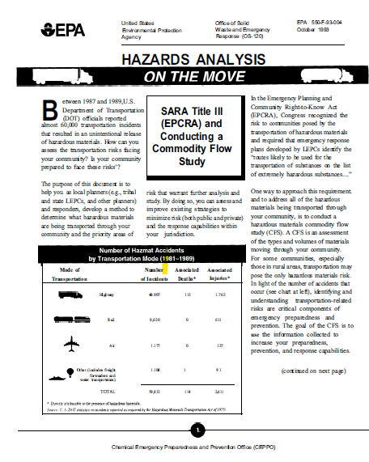

Slide 13
Nicole Coldren and Dr. Thomas Mueller California University of Pennsylvania
CAMEO Internship Penobscot County and Cumberland County Maine
Maine State Emergency Response Commission (ME SERC)
Maine Emergency Management Agency (MEMA)

Slide 14
CAMEO Internship Penobscot County and Cumberland County Maine
Cumberland County Maine
Penobscot County Maine
Facilities with EHS: 128
Routes for these Facilities: 443
Facilities with EHS: 71
Routes for these Facilities: 188

Slide 15
Michael Castro E Stefan Coutoulakis Escape Training, LLC
Mystic Regional Local Emergency Planning Committee (REPC)
Massachusetts State Emergency Response Commission (MA SERC)
Massachusetts Emergency Management Agency (MEMA)

Slide 16
Mystic Regional Local Emergency Planning Committee (REPC)
26 member communities of the Mystic REPC
Facilities with EHS: 128

